Slide 1

Malignant comment classifier
Name: Shivam Namdev Gadekar

Slide 2
Problem Statement
The proliferation of social media enables people to express their opinions widely online. However, at the same time, this has resulted in the emergence of conflict and hate, making online environments uninviting for users. Although researchers have found that hate is a problem across multiple platforms, there is a lack of models for online hate detection.
Online hate, described as abusive language, aggression, cyberbullying, hatefulness and many others has been identified as a major threat on online social media platforms. Social media platforms are the most prominent grounds for such toxic behaviour.
There has been a remarkable increase in the cases of cyberbullying and trolls on various social media platforms. Many celebrities and influences are facing backlashes from people and have to come across hateful and offensive comments. This can take a toll on anyone and affect them mentally leading to depression, mental illness, self-hatred and suicidal thoughts.
Internet comments are bastions of hatred and vitriol. While online anonymity has provided a new outlet for aggression and hate speech, machine learning can be used to fight it. The problem we sought to solve was the tagging of internet comments that are aggressive towards other users. This means that insults to third parties such as celebrities will be tagged as unoffensive, but “u are an idiot” is clearly offensive.
Our goal is to build a prototype of online hate and abuse comment classifier which can used to classify hate and offensive comments so that it can be controlled and restricted from spreading hatred and cyberbullying.

Slide 3
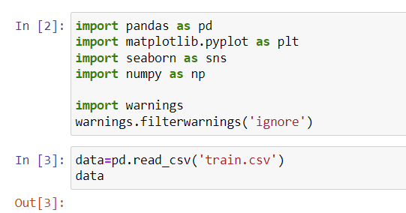
Loading Libraries and Reading Data

Slide 4
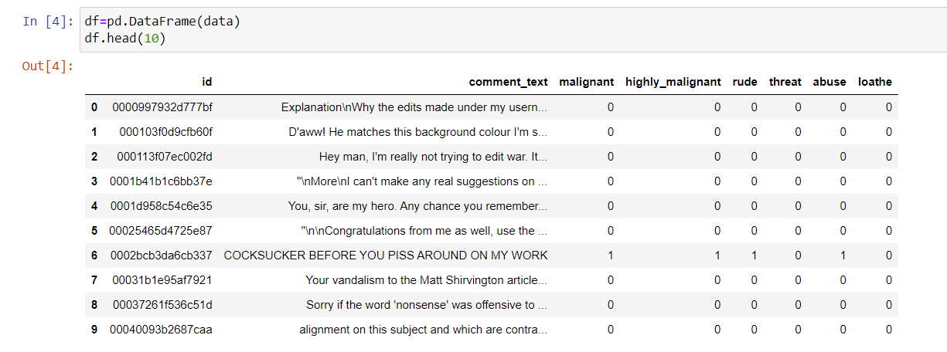
Reading and Printing DataFrame

Slide 5
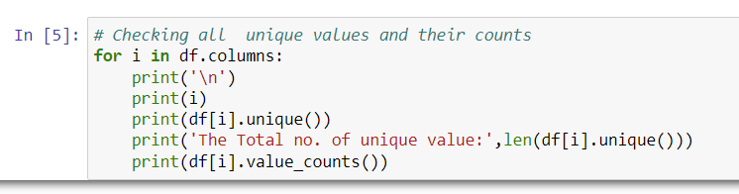
Checking Unique Values

Slide 6
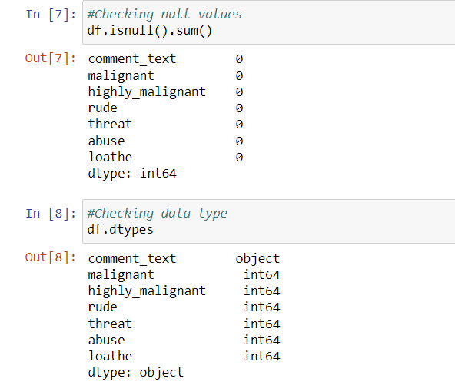
Checking Null Values and Data Type

Slide 7
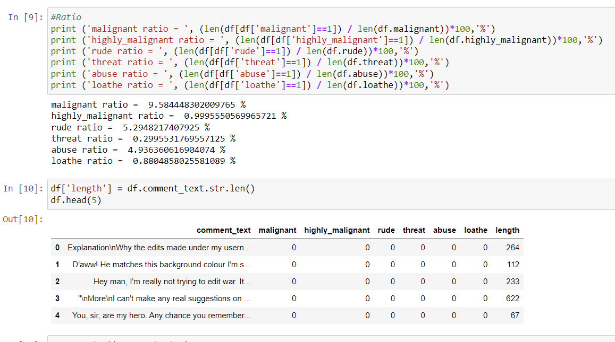
Checking ratio and Lenght

Slide 8
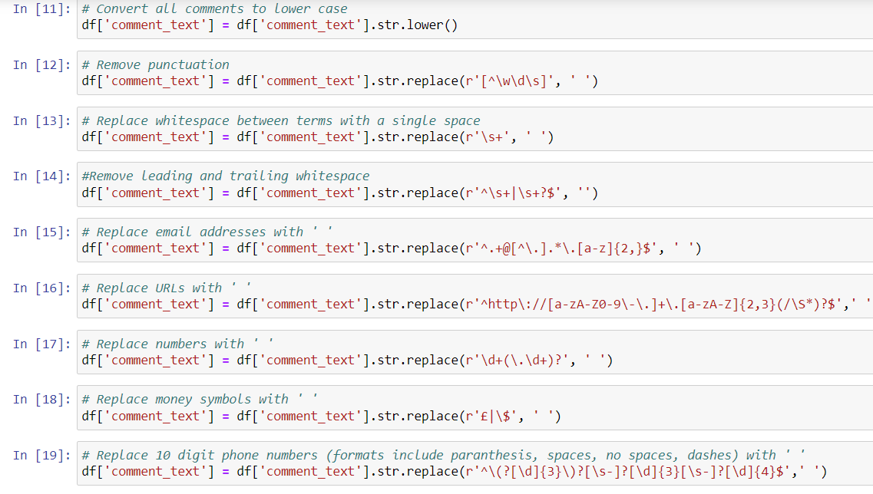
Preprocessing

Slide 9
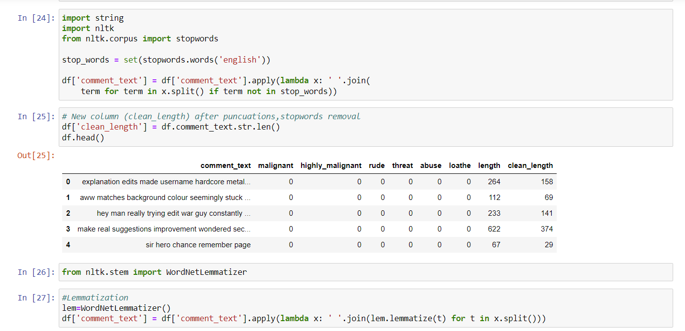
String Formatting and Lammatization

Slide 10
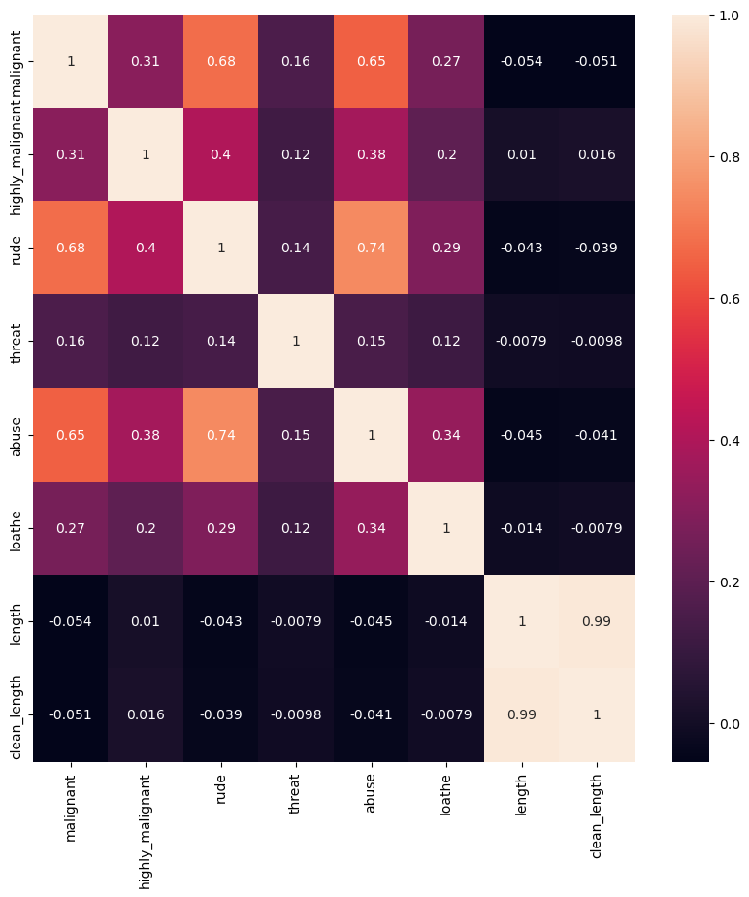
Plotting Correlation Matrix

Slide 11
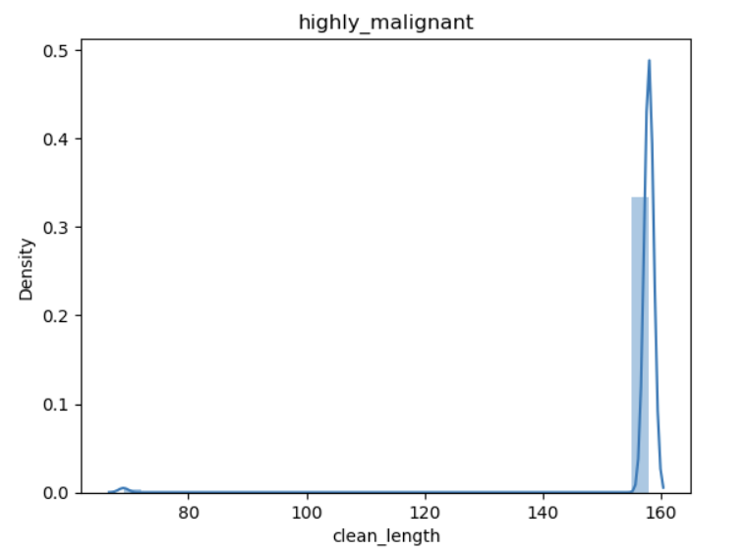
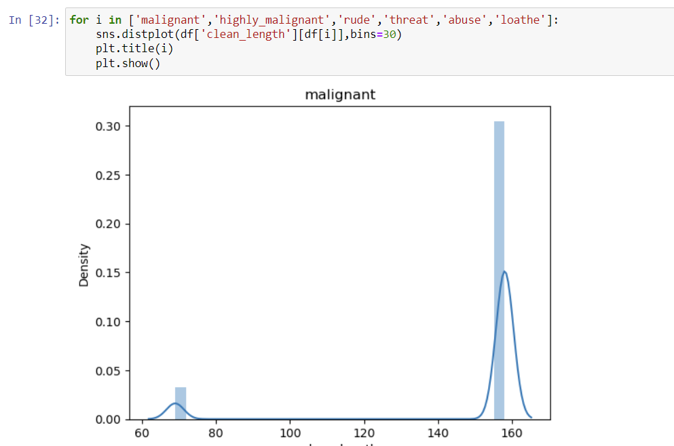
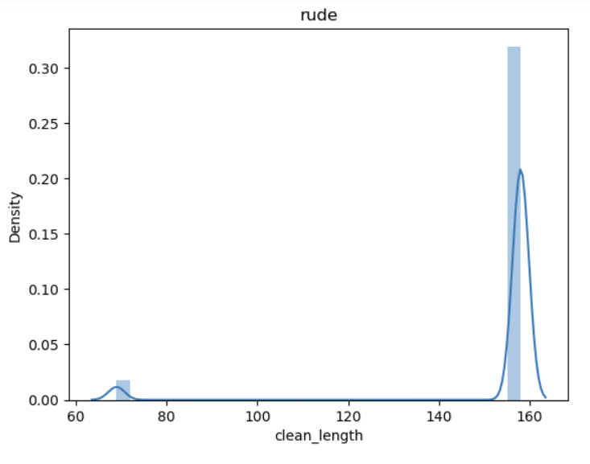
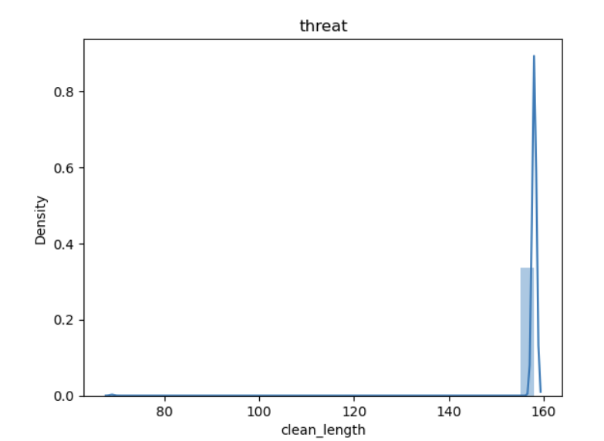
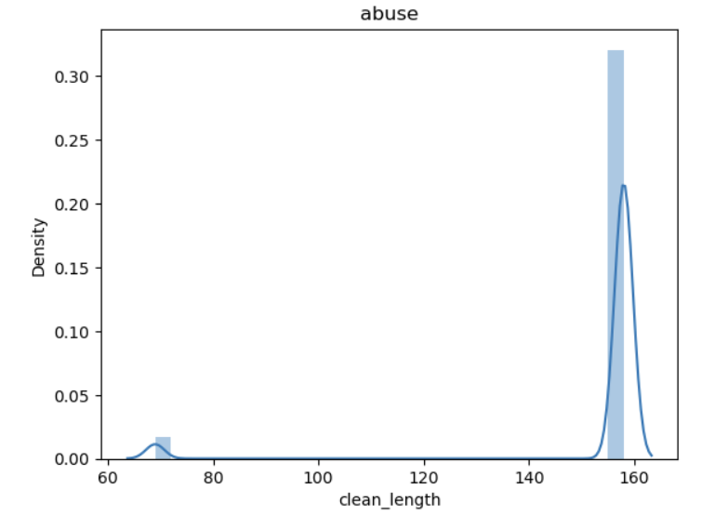
Distplotting

Slide 12
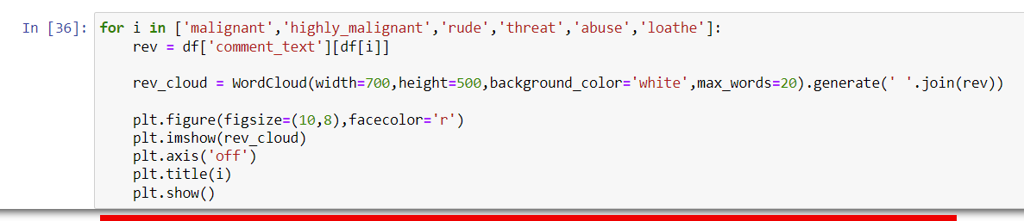
Using Wordcloud

Slide 13
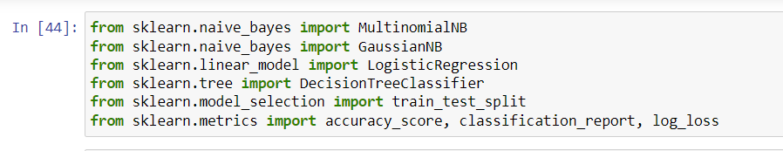
Importing Model

Slide 14
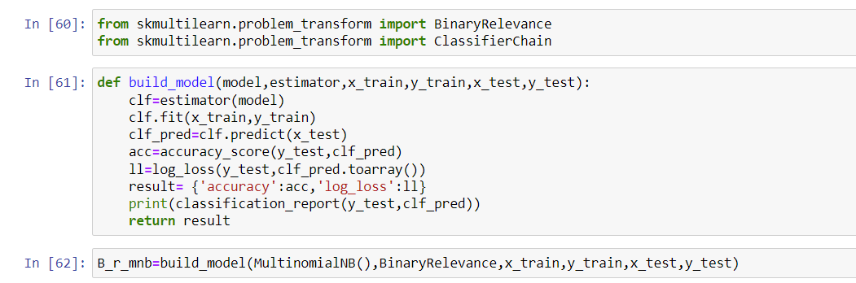
Function Definition and Importing Models and Splitting Data Set

Slide 15
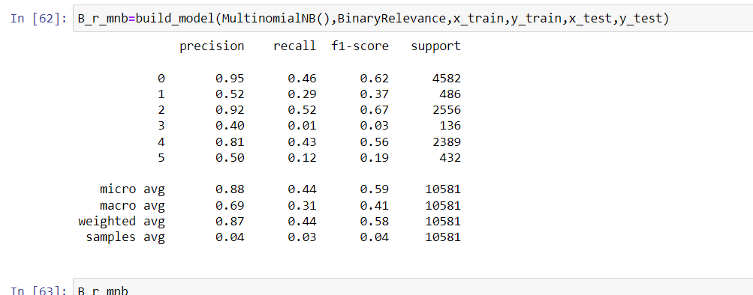
Applying MultinomialNB

Slide 16
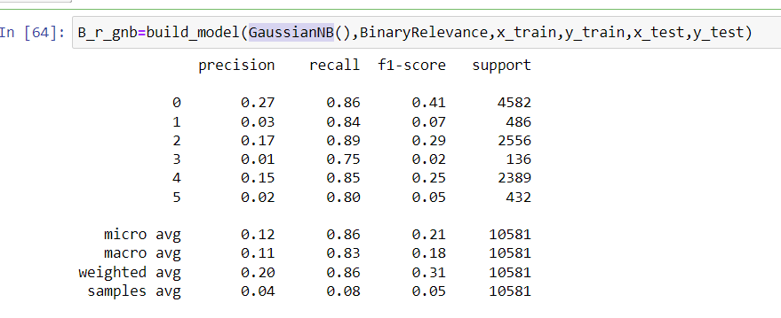
Applying GaussianNB

Slide 17
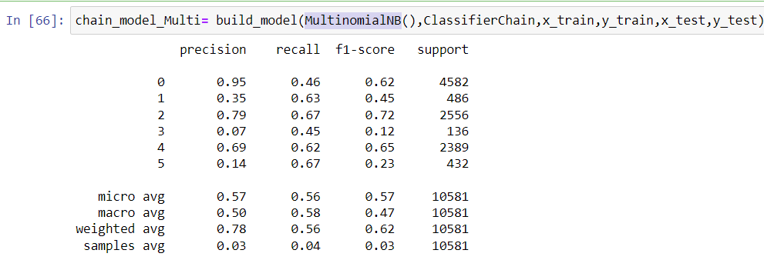
Applying MultinomialNB

Slide 18
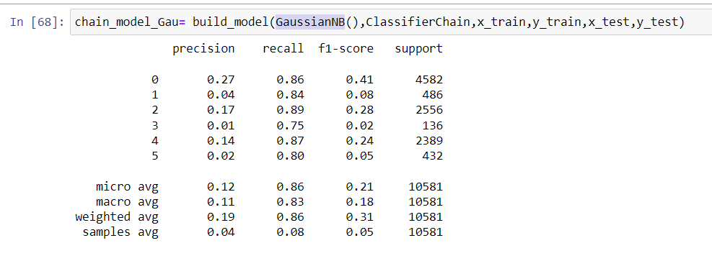
Applying GaussianNB

Slide 19
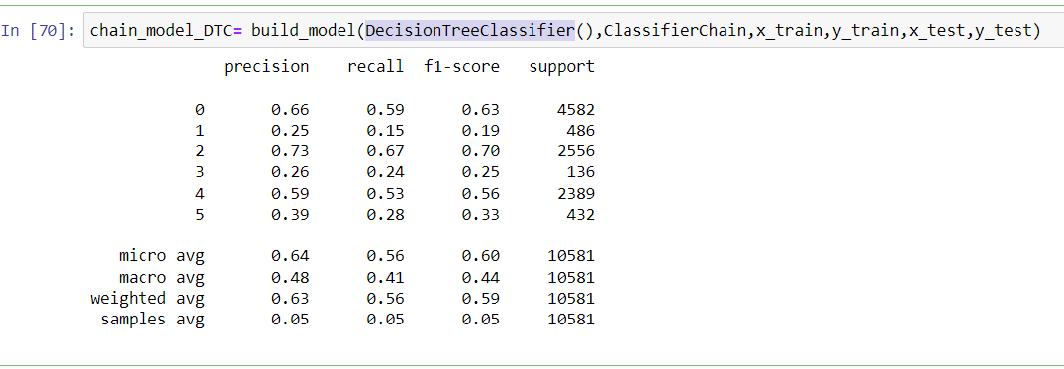
Applying DecisionTreeClassifier

Slide 20
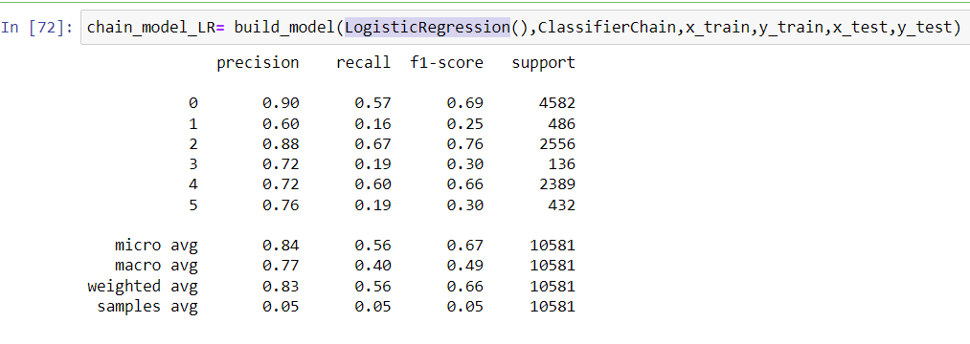
Applying LogisticRegression

Slide 21
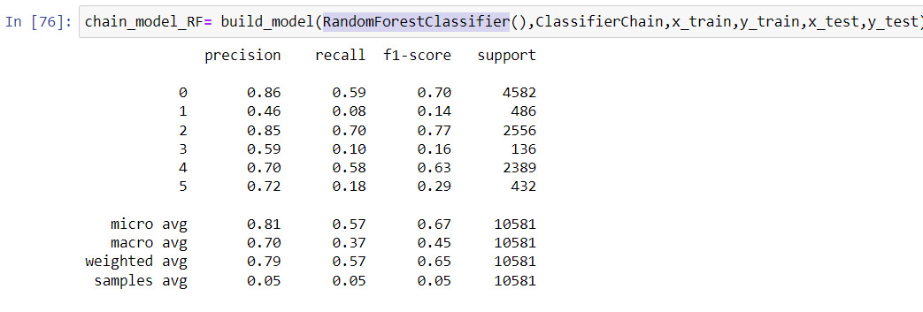
Applying RandomForestClassifier

